Slide 1


VOTER HELPLINE APPLICATION
Languages :
Marathi
Hindi
English

Slide 2
Home page
Search Your Name /EPIC NO
Forms
Complaints
EVM
Elections
Candidates

Slide 3
Voter Services
Forms
Apply online: Transfer Location: Correction/Updation :
New voter Registration
Overseas Voter Registration
Enter your Name
If you want transfer any location
In you want voter card details modifications use correction/updation option
HELP

Slide 4
Register for Complaints
Register Mobile No
Password
Forgot Password

Slide 5
Forgot Password Process
Enter contact No:
OTP on Register Number:
Continue
Resend OTP
Continue

Slide 6
Forgot Password Process
Enter New Password:
Confirm Password:
Submit

Slide 7
First you can login complaints page
if you want to give any complaints on Election process use complaints option
COMPLAINTS

Slide 8
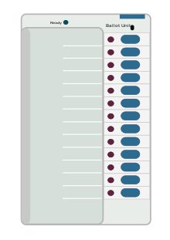
Working of EVM
EVM
The Electronic Voting Machine(EVM),the replacement of the ballot box is mainstay in electoral process.
First time use of EVMs occurred in the general election in kerala in may 1982
Working/History of EVM
Technical Security

Slide 9
Elections Process
Elections
Types of Elections
Past Elections
Upcoming Elections
Election Results

Slide 10
Types of Elections
Members of the Parliament in LokSabha
Members of State Legislative Assemblies
Members of the Parliament in Rajya Sabha
Past Elections
General Election 2019
Assembly Elections
Bye Elections

Slide 11
Upcoming Elections
Goa Assembly Elections
Manipur Assembly Elections
Punjab Assembly Elections
Election Results
Statistical Reports of general election to loksabha

Slide 12
Search Candidate
Candidate
Search
Name of Candidate
Photo of Candidate
Party name
Place
Name of the Candidate
Accepted
Rejected

Slide 13
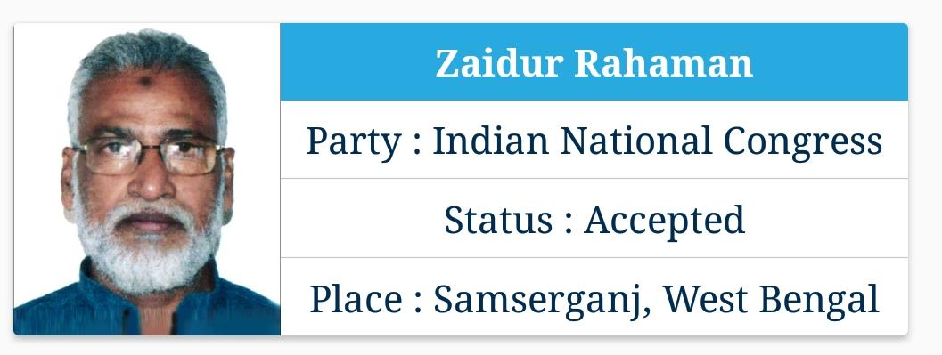
Status Accept/Reject
In the above all fields are mandatory
You can fill the all details then accepted otherwise rejected

Slide 14
Thank You
Thank you for visit the Voter helpline application

